Slide 1
Memory Management

Slide 2
Memory management
Ideally programmers want memory that is
large
fast
non volatile
Memory hierarchy
small amount of fast, expensive memory – cache
some medium-speed, medium price main memory
gigabytes of slow, cheap disk storage
Memory manager handles the memory hierarchy

Slide 3
Memory management
We have seen how CPU can be shared by a set of processes
Improve system performance
Process management
Need to keep several process in memory
Share memory
Learn various techniques to manage memory
Hardware dependent

Slide 4
Memory management
What are we going to learn?
Basic Memory Management: logical vs. physical address space, protection, contiguous memory allocation, paging, segmentation, segmentation with paging.
Virtual Memory: background, demand paging, performance, page replacement, page replacement algorithms (FCFS, LRU), allocation of frames, thrashing.

Slide 5

Background
Program must be brought (from disk) into memory
Fetch-decode-execute cycle
Memory unit only sees a stream of addresses + read requests, or address + data and write requests
Sequence of memory addresses generated by running program
CPU

Slide 6

Logical vs. Physical Address Space
Logical address – generated by the CPU; also referred to as virtual address
Physical address – address seen by the memory unit
Logical address space is the set of all logical addresses generated by a program
Physical address space is the set of all physical addresses generated by a program
CPU

Slide 7
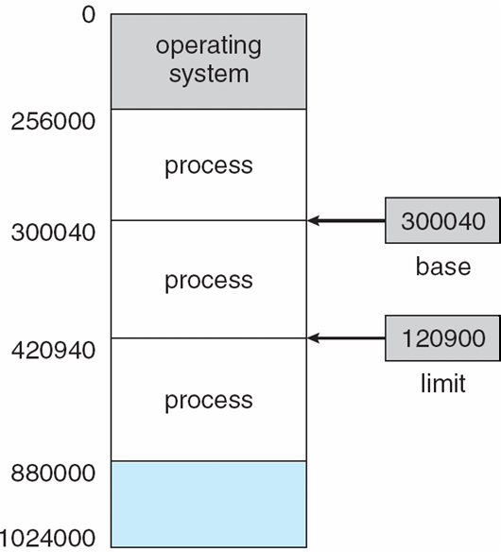
Background
Multiple processes resides in memory
Protection of memory required to ensure correct operation
1. Protect OS
2. Protect user processes

Slide 8
Base and Limit Registers
A pair of base and limit registers define the logical address space

Slide 9
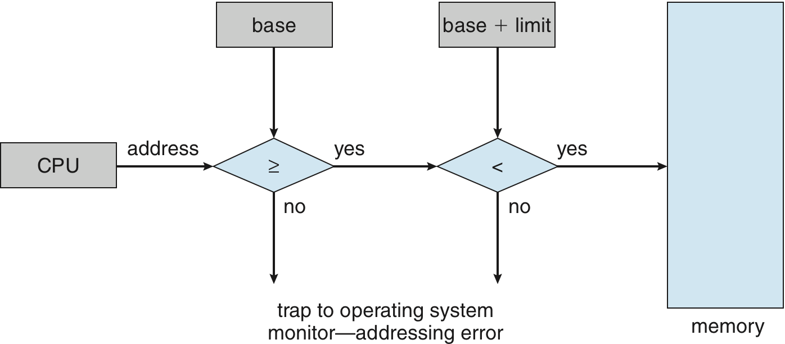
Hardware Address Protection with Base and Limit Registers
OS loads the base & limit reg.
Privileged instruction

Slide 10
Address Binding
Process resides in main memory
Associate each data element with memory address
Further, addresses represented in different ways at different stages of a program’s life
Source code addresses usually symbolic
Compiled code addresses bind to relocatable addresses
i.e. “14 bytes from beginning of this module”
Linker or loader will bind relocatable addresses to absolute addresses
i.e. 74014

Slide 11
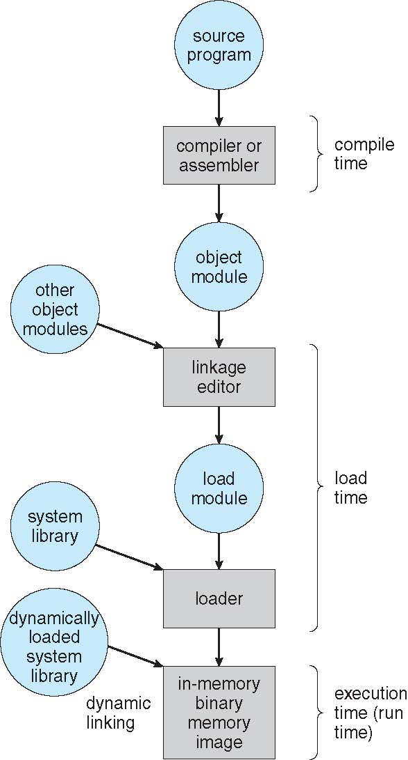
Multistep Processing of a User Program

Slide 12
Binding of Instructions and Data to Memory
Address binding of instructions and data to memory addresses can happen at three different stages
Compile time: If memory location known a priori, absolute code can be generated; must recompile code if starting location changes
Load time: Must generate relocatable code if memory location is not known at compile time
Execution time: If the process can be moved during its execution from one memory segment to another
Binding delayed until run time
Need hardware support for address maps (e.g., base and limit registers)

Slide 13
Logical vs. Physical Address Space
Logical address – generated by the CPU; also referred to as virtual address
Physical address – address seen by the memory unit
Logical and physical addresses are the same in compile-time and load-time address-binding schemes;
logical (virtual) and physical addresses differ in execution-time address-binding scheme
Logical address space is the set of all logical addresses generated by a program
Physical address space is the set of all physical addresses generated by a program
CPU

Slide 14
Memory-Management Unit (MMU)
Hardware device that at run time maps virtual to physical address
Many methods possible
To start, consider simple scheme where the value in the relocation register is added to every address generated by a user process at the time it is sent to memory
relocation register
MS-DOS on Intel 80x86 used 4 relocation registers
The user program deals with logical addresses (0 to max); it never sees the real physical addresses (R to R+max)
Say the logical address 25
Execution-time binding occurs when reference is made to location in memory
Logical address bound to physical addresses

Slide 15
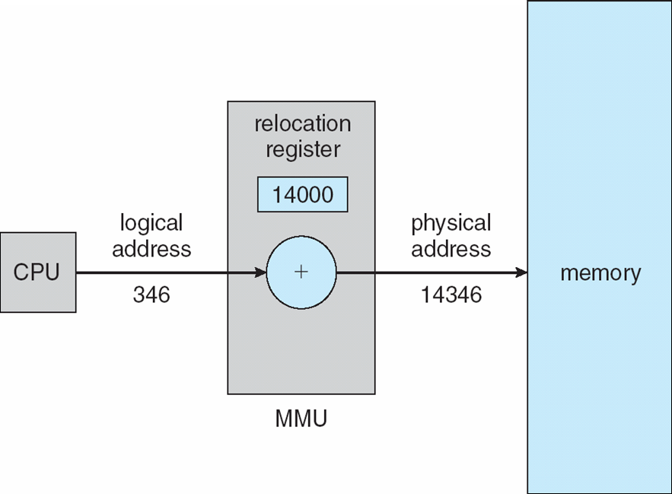
Dynamic relocation using a relocation register
14000
Relocatable code

Slide 16
Contiguous Allocation
Multiple processes resides in memory

Slide 17
Contiguous Allocation
Main memory usually divided into two partitions:
Resident operating system, usually held in low memory
User processes then held in high memory
Each process contained in single contiguous section of memory

Slide 18
Contiguous Allocation (Cont.)
Multiple-partition allocation
Divide memory into several Fixed size partition
Each partition stores one process
Degree of multiprogramming limited by number of partitions
If a partition is free, load process from job queue
MFT (IBM OS/360)

Slide 19
Contiguous Allocation (Cont.)
Multiple-partition allocation
Variable partition scheme
Hole – block of available memory; holes of various size are scattered throughout memory
Keeps a table of free memory
When a process arrives, it is allocated memory from a hole large enough to accommodate it
Process exiting frees its partition, adjacent free partitions combined
Operating system maintains information about: a) allocated partitions b) free partitions (hole)
OS
OS
OS
OS
OS
process 5
process 5
process 5
process 5
process 9
process 9
Hole
process 8
process 10
process 2
process 2
process 2
process 2

Slide 20
Dynamic Storage-Allocation Problem
How to satisfy a request of size n from a list of free holes?
Dynamic storage allocation problem
First-fit: Allocate the first hole that is big enough
Best-fit: Allocate the smallest hole that is big enough; must search entire list, unless ordered by size
Produces the smallest leftover hole
Worst-fit: Allocate the largest hole; must also search entire list
Produces the largest leftover hole

Slide 21

Hardware Support for Relocation and Limit Registers
Relocation registers used to protect user processes from each other, and from changing operating-system code and data
Relocation register contains value of smallest physical address
Limit register contains range of logical addresses – each logical address must be less than the limit register
Context switch
MMU maps logical address dynamically

Slide 22
Fragmentation
Processes loaded and removed from memory
Memory is broken into little pieces
External Fragmentation – total memory space exists to satisfy a request, but it is not contiguous
First fit analysis reveals that given N blocks allocated, 0.5 N blocks lost to fragmentation
1/3 may be unusable -> 50-percent rule

Slide 23
Fragmentation (Cont.)
Reduce external fragmentation by compaction
Shuffle memory contents to place all free memory together in one large block
Compaction is possible only if relocation is dynamic, and is done at execution time
Change relocation reg.
Cost
Internal Fragmentation – allocated memory may be slightly larger than requested memory; this size difference is memory internal to a partition, but not being used

Slide 24
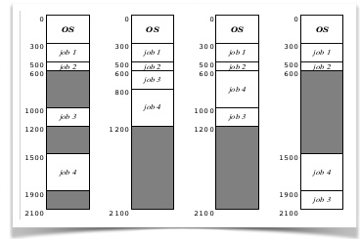

Slide 25
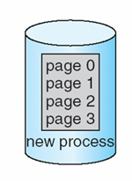
Paging
Physical address space of a process can be noncontiguous;
process allocates physical memory whenever the latter is available
Divide physical memory into fixed-sized blocks called frames
Size is power of 2, between 512 bytes and 16 Mbytes
Divide logical memory into blocks of same size called pages
To run a program of size N pages, need to find N free frames and load program
Backing store likewise split into pages
Set up a page table to translate logical to physical addresses
System keeps track of all free frames

Slide 26

Paging Model of Logical and Physical Memory
page table to translate logical to physical addresses

Slide 27
Address Translation Scheme
Address generated by CPU is divided into:
Page number (p) – used as an index into a page table
which contains base address of each page in physical memory
Page offset (d) – offset within a page
combined with base address to define the physical memory address that is sent to the memory unit
For given logical address space 2^{m} and page size 2^{n}
offset
page
page number
page offset
p
d
m - n
n

Slide 28
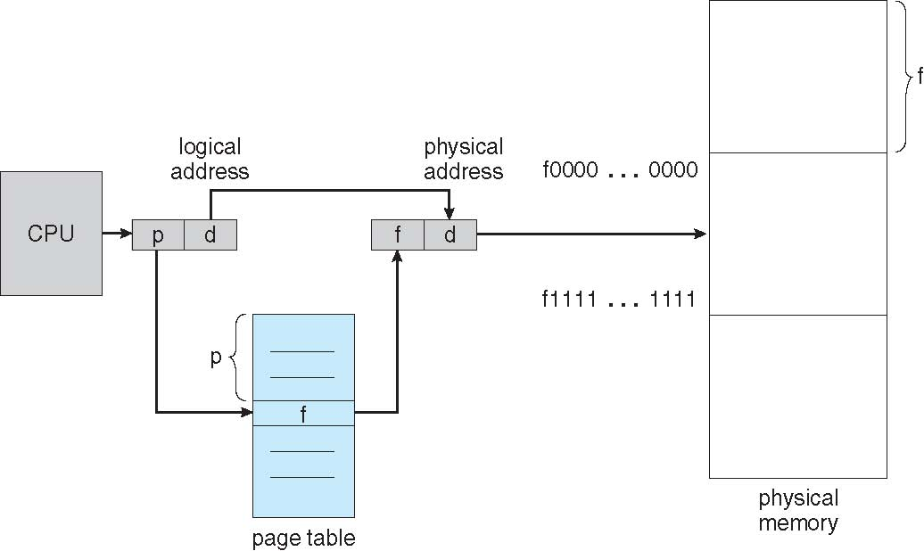
Paging Hardware

Slide 29

Paging Example
Logical address 0
(0*4+0)
Physical address: (5*4+0)=20
Logical address 3
(0*4+3)
Physical address:
(5*4+0)=23
Logical address 4
(1*4+0)
Physical address:
(6*4+0)=24
Logical address 13
(3*4+1)
Physical address: (2*4+1)
Logical address = 16
Page size=4
Physical memory=32
User’s view
Run time address binding
n=2 and m=4 32-byte memory and 4-byte pages

Slide 30
Paging
External fragmentation??
Calculating internal fragmentation
Page size = 2,048 bytes
Process size = 72,766 bytes
35 pages + 1,086 bytes
Internal fragmentation of 2,048 - 1,086 = 962 bytes
So small frame sizes desirable?
But increases the page table size
Poor disk I/O
Page sizes growing over time
Solaris supports two page sizes – 8 KB and 4 MB
User’s view and physical memory now very different
user view=> process contains in single contiguous memory space
By implementation process can only access its own memory
protection

Slide 31
Each page table entry 4 bytes (32 bits) long
Each entry can point to 2³² page frames
If each frame is 4 KB
The system can address 2⁴⁴ bytes (16TB) of physical memory
Virtual address space 16MB.
Page table size?

Slide 32
Process P1 arrives
Requires n pages => n frames must be available
Allocate n frames to the process P1
Create page table for P1

Slide 33

Free Frames
Frame table
Use’s view
System’s view
RAM
RAM
Before allocation
After allocation

Slide 34
Implementation of Page Table
For each process, Page table is kept in main memory
Page-table base register (PTBR) points to the page table
Page-table length register (PTLR) indicates size of the page table
In this scheme every data/instruction access requires two memory accesses
One for the page table and one for the data / instruction
The two memory access problem can be solved by the use of a special fast-lookup hardware cache called associative memory or translation look-aside buffers (TLBs)

Slide 35
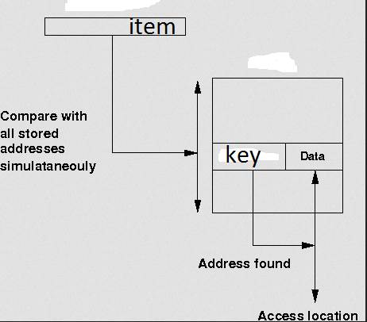
Associative memory

Slide 36
Associative Memory
Associative memory – parallel search
Address translation (p, d)
If p is in associative register, get frame # out
Otherwise get frame # from page table in memory
Page #
Frame #

Slide 37
Implementation of Page Table
For each process, Page table is kept in main memory
Page-table base register (PTBR) points to the page table
Page-table length register (PTLR) indicates size of the page table
In this scheme every data/instruction access requires two memory accesses
One for the page table and one for the data / instruction
The two memory access problem can be solved by the use of a special fast-lookup hardware cache called associative memory or translation look-aside buffers (TLBs)
TLBs typically small (64 to 1,024 entries)
On a TLB miss, value is loaded into the TLB for faster access next time
Replacement policies must be considered (LRU)
Some entries can be wired down for permanent fast access
Some TLBs store address-space identifiers (ASIDs) in each TLB entry – uniquely identifies each process (PID) to provide address-space protection for that process
Otherwise need to flush at every context switch

Slide 38

Paging Hardware With TLB

Slide 39
Effective Access Time
Associative Lookup = ε time unit
Can be < 10% of memory access time
Hit ratio = α
Hit ratio – percentage of times that a page number is found in the associative registers; ratio related to size of TLB
Consider α = 80%, ε = 20ns for TLB search, 100ns for memory access
Effective Access Time (EAT)
EAT = (100 + ε) α + (200 + ε)(1 – α)
Consider α = 80%, ε = 20ns for TLB search, 100ns for memory access
EAT = 0.80 x 120 + 0.20 x 220 = 140ns
Consider better hit ratio -> α = 98%, ε = 20ns for TLB search, 100ns for memory access
EAT = 0.98 x 120 + 0.02 x 220 = 122ns

Slide 40
Memory Protection
Memory protection implemented by associating protection bit with each frame to indicate if read-only or read-write access is allowed
Can also add more bits to indicate page execute-only, and so on
Valid-invalid bit attached to each entry in the page table:
“valid” indicates that the associated page is in the process’ logical address space, and is thus a legal page
“invalid” indicates that the page is not in the process’ logical address space
Or use PTLR
Any violations result in a trap to the kernel

Slide 41

Valid (v) or Invalid (i) Bit In A Page Table
14 bit address space (0 to 16383)
Page size 2KB
Process P1 uses only 0 to 10468
P2
Page 0
Page 1
Page 2
Page 3
P1
Internal fragmentation
Use of PTLR (length)

Slide 42
Shared Pages Example
System with 40 users
Use common text editor
Text editor contains 150KB code 50KB data (page size 50KB)
8000KB!
Shared code
One copy of read-only (reentrant) code shared among processes (i.e., text editors, compilers, window systems)
Code never changes during execution
Only one copy of the editor in the memory
Total memory consumption
40*50+150=2150KB

Slide 43
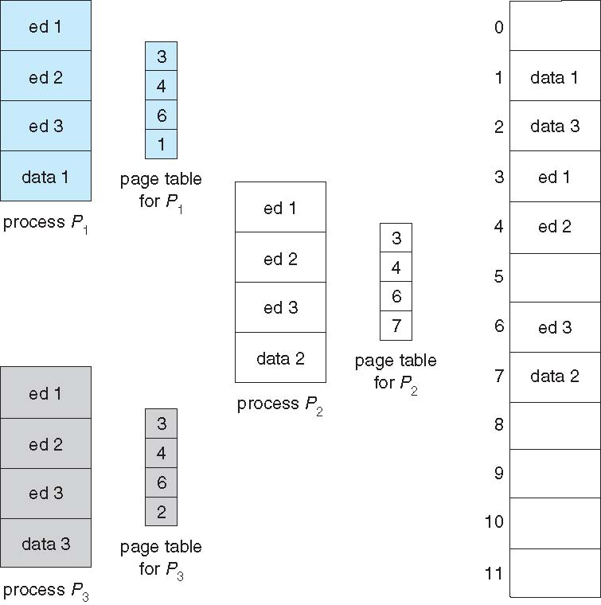
Shared Pages Example

Slide 44
Data share: example
writer.c
reader .c
int main()
{
int shmid,f,key=3,i,pid;
char *ptr;
shmid=shmget((key_t)key,100,IPC_CREAT|0666);
ptr=shmat(shmid,NULL,0);
printf("shmid=%d ptr=%u\n",shmid, ptr);
strcpy(ptr,"hello");
i=shmdt((char*)ptr);
}
int main()
{
int shmid,f,key=3,i,pid;
char *ptr;
shmid=shmget((key_t)key,100,IPC_CREAT|0666);
ptr=shmat(shmid,NULL,0);
printf("shmid=%d ptr=%u\n",shmid, ptr);
printf("\nstr %s\n",ptr);
}
ptr
Shared memory

Slide 45
Structure of the Page Table
Memory requirement for page table can get huge using straight-forward methods
Consider a 32-bit logical address space as on modern computers
Page size of 4 KB (2¹²)
Page table would have 1 million entries 2²⁰ (2³² / 2¹²)
If each entry is 4 bytes -> 4 MB of physical address space / memory for page table alone
That amount of memory used to cost a lot
Don’t want to allocate that contiguously in main memory
Hierarchical Paging
Hashed Page Tables
Inverted Page Tables

Slide 46
Hierarchical Page Tables
Break up the page table into multiple pages
We then page the page table
A simple technique is a two-level page table

Slide 47

Two-Level Page-Table Scheme

Slide 48
Two-Level Paging Example
A logical address (on 32-bit machine with 4KB page size) is divided into:
a page number consisting of 20 bits
a page offset consisting of 12 bits
Since the page table is paged, the page number is further divided into:
a 10-bit page number
a 10-bit page offset
Thus, a logical address is as follows:
where p₁ is an index into the outer page table, and p₂ is the displacement within the page of the inner page table
page number
page offset
p₁
p₂
d
10
10
12

Slide 49
Two-Level Page-Table Scheme
Each divided page table size=2¹⁰ *4bytes=4KB
=Page size
d
p₁
p₂
Pentium II

Slide 50

Address-Translation Scheme
Pentium II

Slide 51
64-bit Logical Address Space
Even two-level paging scheme not sufficient
If page size is 4 KB (2¹²)
Then page table has 2⁵² entries
If two level scheme, inner page tables could be 2¹⁰ 4-byte entries
Address would look like
Outer page table has 2⁴² entries or 2⁴⁴ bytes
One solution is to add a 2nd outer page table
But in the following example the 2nd outer page table is still 2³⁴ bytes in size
And possibly 4 memory access to get to one physical memory location
inner page
outer page
page offset
p₁
p₂
d
42
10
12

Slide 52


Three-level Paging Scheme
SPARC (32 bits), Motorola 68030 support three and four level paging respectively

Slide 53
Hashed Page Tables
Common in virtual address spaces > 32 bits
The page number is hashed into a page table
This page table contains a chain of elements hashing to the same location
Each element contains (1) the page number (2) the value of the mapped page frame (3) a pointer to the next element
Virtual page numbers are compared in this chain searching for a match
If a match is found, the corresponding physical frame is extracted

Slide 54

Hashed Page Table

Slide 55
Inverted Page Table
Rather than each process having a page table and keeping track of all possible logical pages, track all frames
One entry for each frame
Entry consists the page number stored in that frame, with information about the process that owns that page
Decreases memory needed to store each page table,
but increases time needed to search the table when a page reference occurs

Slide 56

Inverted Page Table Architecture
64 bit UltraSPARC, PowerPC,
Address space ID

Slide 57
Segmentation
Memory-management scheme that supports user view of memory
A program is a collection of segments
A segment is a logical unit such as:
main program
procedure
function
method
object
local variables, global variables
common block
stack
symbol table
arrays
Compiler generates the segments
Loader assign the seg#

Slide 58
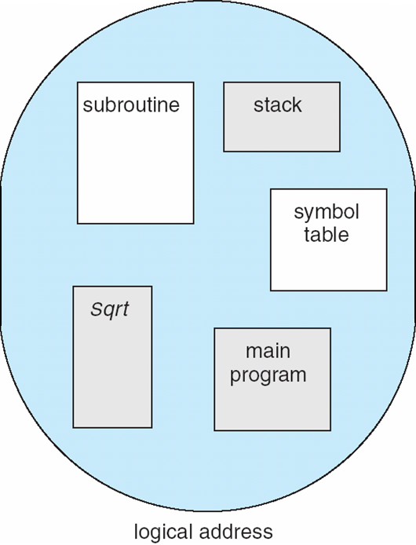
User’s View of a Program
User specifies each address by two quantities
Segment name
Segment offset
Logical address contains the tuple
<segment#, offset>
Variable size segments without order
Length=> purpose of the program
Elements are identified by offset

Slide 59
Logical View of Segmentation
Logical address <segment-number, offset>
1
1
4
2
3
4
2
3
Logical address space
user space
physical memory space
Long term scheduler finds and allocates memory for all segments of a program
Variable size partition scheme

Slide 60
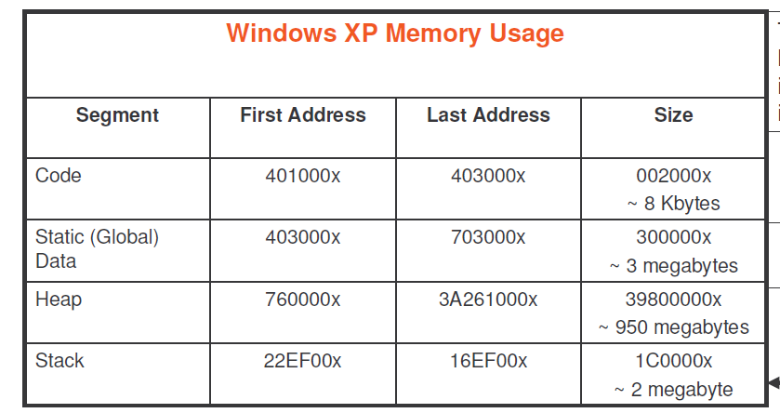

Slide 61
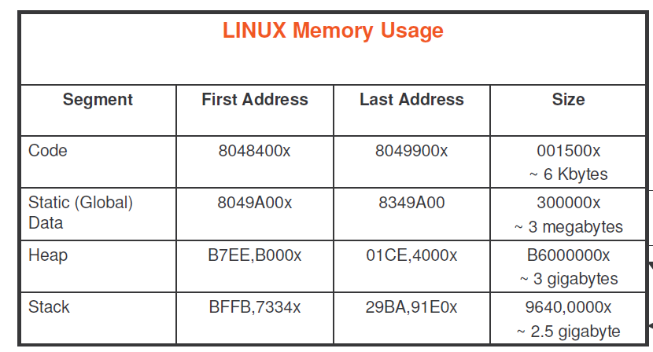

Slide 62
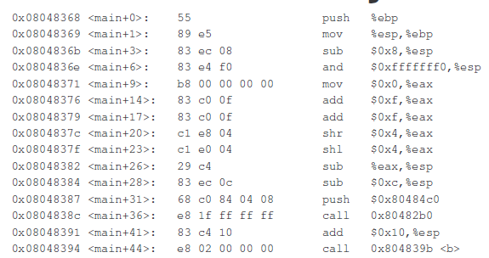
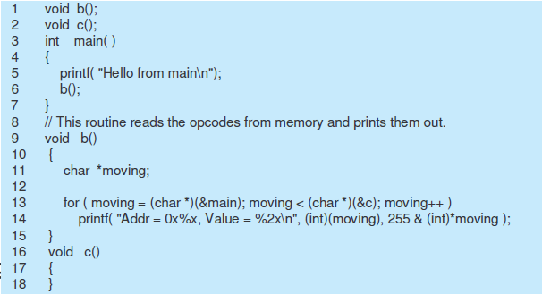
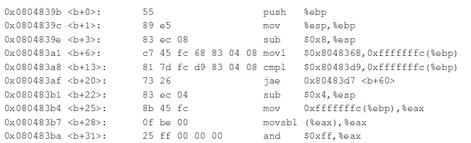
Memory image

Slide 63
Executable file and virtual address
Symbol table
Name | address
SQR | 0
SUM | 4
a.out
Virtual address space
Paging view
0 Load 0
4 ADD 4
Segmentation view
<CODE, 0> Load <ST,0>
<CODE, 2> ADD <ST,4>

Slide 64
Segmentation Architecture
Logical address consists of a two tuple:
<segment-number, offset>
Segment table – maps two-dimensional logical address to physical address;
Each table entry has:
base – contains the starting physical address where the segments reside in memory
limit – specifies the length of the segment
Segment-table base register (STBR) points to the segment table’s location in memory
Segment-table length register (STLR) indicates number of segments used by a program;
segment number s is legal if s < STLR

Slide 65
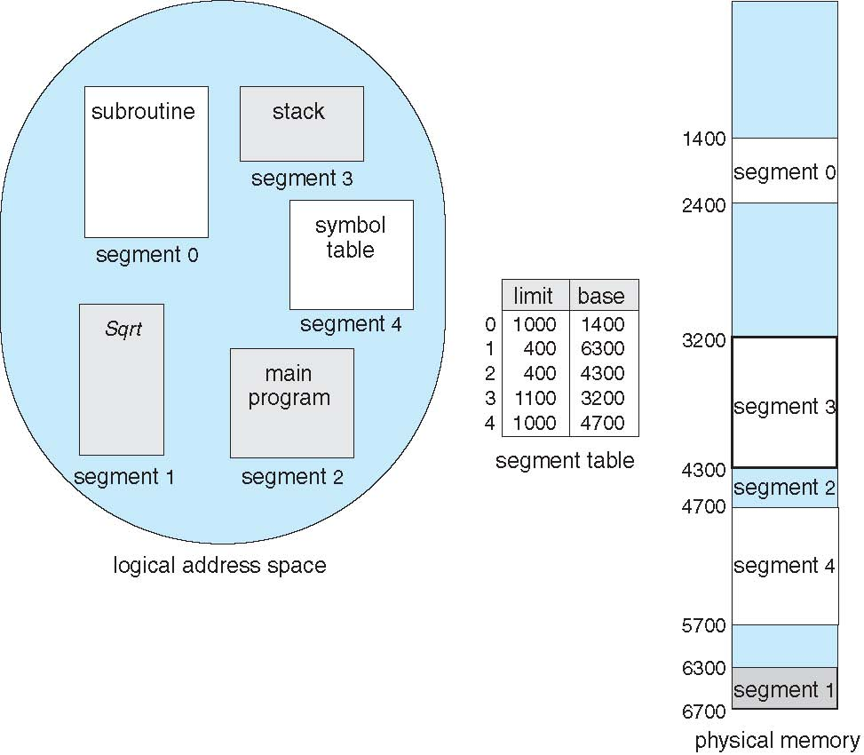
Example of Segmentation

Slide 66
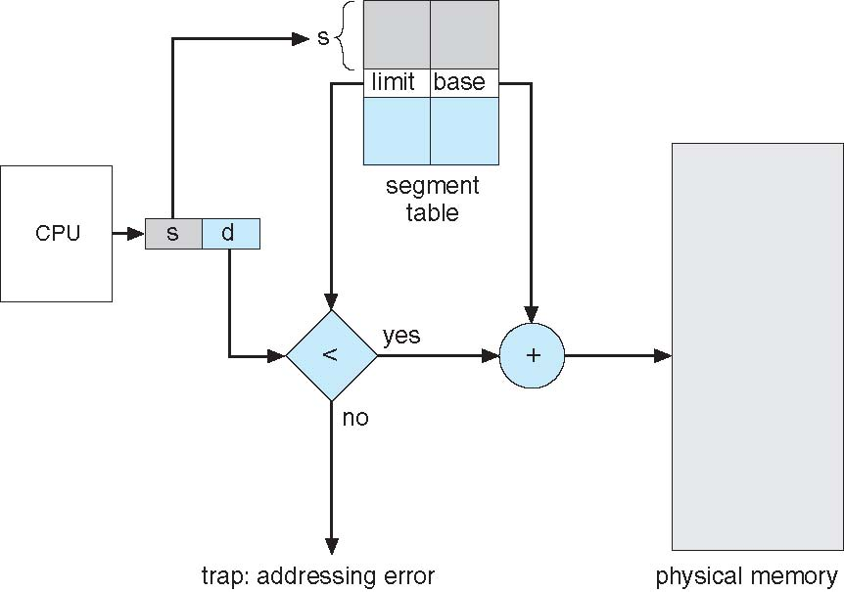
Segmentation Hardware

Slide 67
Example of Segmentation

Slide 68
Segmentation Architecture
Protection
Protection bits associated with segments
With each entry in segment table associate:
validation bit = 0 ⇒ illegal segment
read/write/execute privileges
Code sharing occurs at segment level
Since segments vary in length, memory allocation is a dynamic storage-allocation problem
Long term scheduler
First fit, best fit etc
Fragmentation

Slide 69
Segmentation with Paging
Key idea:
Segments are splitted into multiple pages
Each page is loaded into frames in the memory

Slide 70
Segmentation with Paging
Supports segmentation with paging
Each segment can be 4 GB
Up to 16 K segments per process
<selector(16), offset (32)>
Divided into two partitions
First partition of up to 8 K segments are private to process (kept in local descriptor table LDT)
Second partition of up to 8K segments shared among all processes (kept in global descriptor table GDT)
CPU generates logical address (six Segment Reg.)
Given to segmentation unit
Which produces linear addresses
Physical address 32 bits
Linear address given to paging unit
Which generates physical address in main memory
Paging units form equivalent of MMU
Pages sizes can be 4 KB
S(13) | G(1) | P(2)
Intel 80386
IBM OS/2

Slide 71
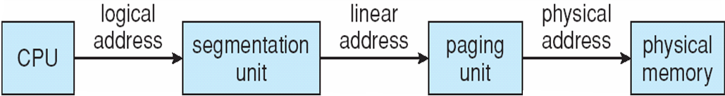
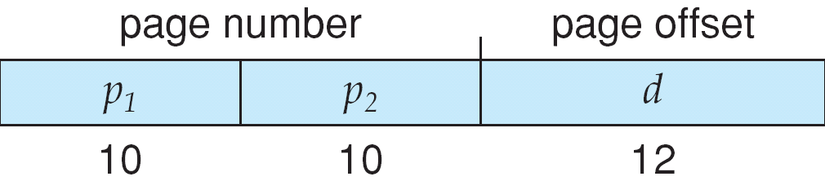
Logical to Physical Address Translation in Pentium
Page table=2²⁰ entries

Slide 72
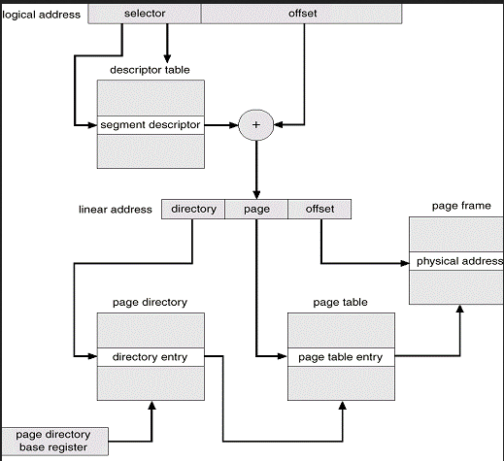
Example: The Intel Pentium
8 bytes
Segment register

Slide 73
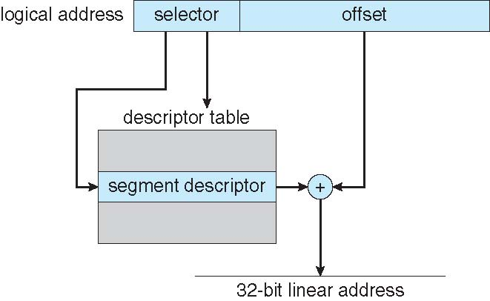
Intel Pentium Segmentation

Slide 74
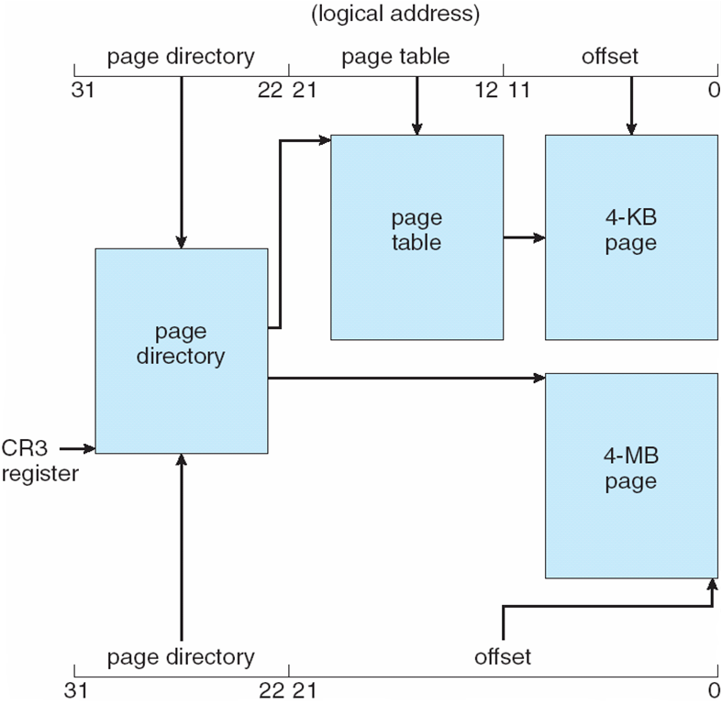
Pentium Paging Architecture

Slide 75
Virtual Memory

Slide 76
Background
Code needs to be in memory to execute, but entire program rarely used
Error code, unusual routines, large data structures
Entire program code not needed at same time
Consider ability to execute partially-loaded program
Program no longer constrained by limits of physical memory
programs could be larger than physical memory
More processes can be accommodated

Slide 77
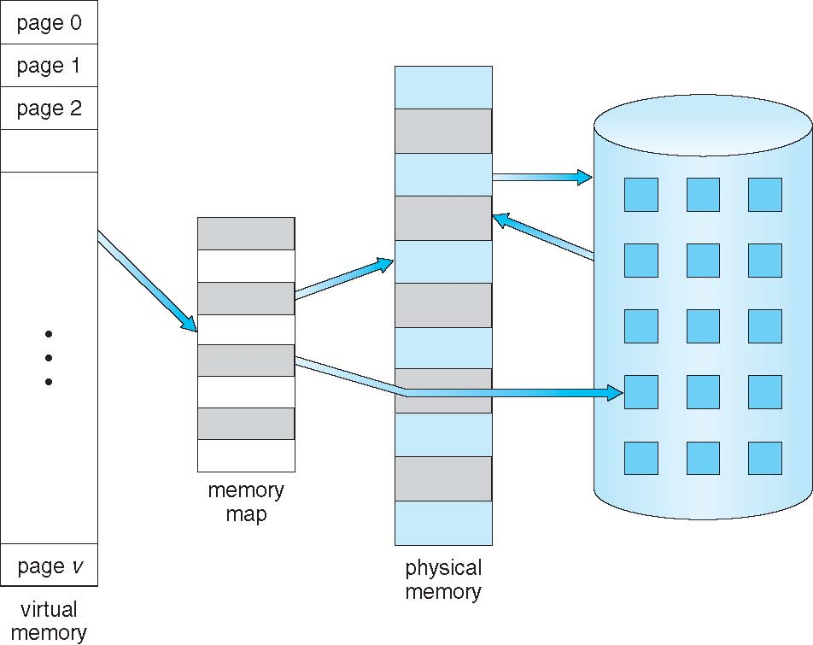
Virtual Memory That is Larger Than Physical Memory
Large virtual space
Small memory

Slide 78
Classical paging
Process P1 arrives
Requires n pages => n frames must be available
Allocate n frames to the process P1
Create page table for P1
Allocate < n frames

Slide 79
Background
Virtual memory – separation of user logical memory from physical memory
Extremely large logical space is available to programmer
Concentrate on the problem
Only part of the program needs to be in memory for execution
Logical address space can therefore be much larger than physical address space
Starts with address 0, allocates contiguous logical memory
Physical memory
Collection of frame
Virtual memory can be implemented via:
Demand paging
Demand segmentation

Slide 80
Demand Paging
Bring a page into memory only when it is needed
Lazy swapper – never swaps a page into memory unless page will be needed
Swapper that deals with pages is a pager
Less I/O needed, no unnecessary I/O
Less memory needed
More users
Page is needed ⇒ reference to it
invalid reference ⇒ abort
not-in-memory ⇒ bring to memory
Valid address information is available in PCB

Slide 81
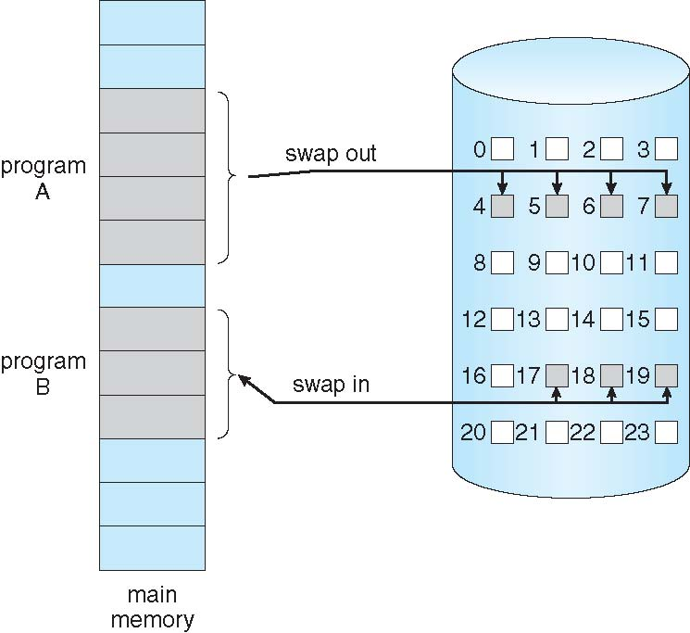
Transfer of a Paged Memory to Contiguous Disk Space
When we want to execute a process, swap in
Instead of swap in entire process, load page
Pager

Slide 82
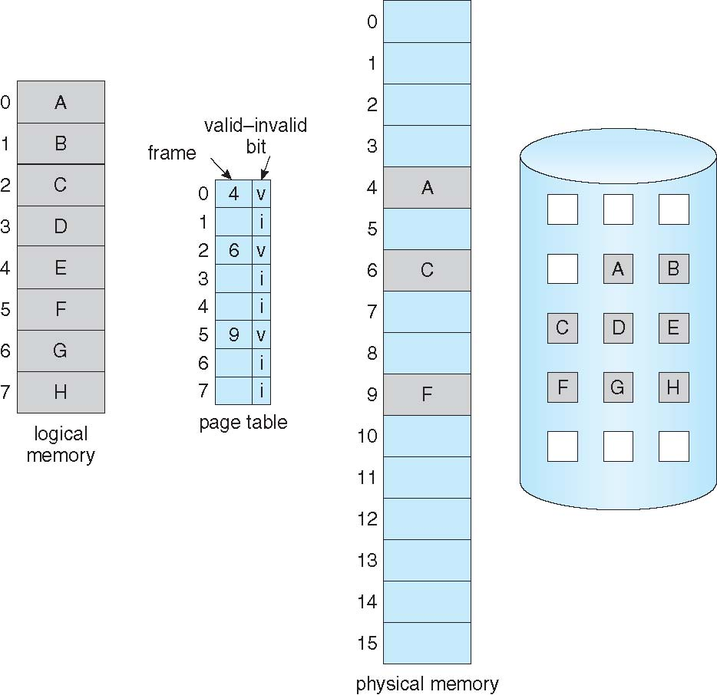
Page Table When Some Pages Are Not in Main Memory
Pager loads few necessary pages in memory

Slide 83
Valid-Invalid Bit
With each page table entry a valid–invalid bit is associated (v ⇒ in-memory – memory resident, i ⇒ not-in-memory)
Initially valid–invalid bit is set to i on all entries
Example of a page table snapshot:
During address translation, if valid–invalid bit in page table entry
is i ⇒ page fault
Frame #
valid-invalid bit
v
v
v
v
i
page table
….
i
Disk address
i

Slide 84
Page Fault
If the page in not in memory, first reference to that page will trap to operating system:
page fault
Operating system looks at PCB to decide:
Invalid reference ⇒ abort
Just not in memory (load the page)
Get empty frame
Swap page into frame via scheduled disk operation
Reset page table to indicate page now in memory Set validation bit = v
Restart the instruction that caused the page fault

Slide 85
What Happens if There is no Free Frame?
Example
40 frames in memory
8 processes each needs 10 pages
5 of them never used
Two options
Run 4 processes (10 pages)
Run 8 processes (5 pages)
Increase the degree of multiprogramming
Over allocating memory
Page fault
No free frame
Terminate? swap out? replace the page?
Page replacement – find some page in memory, not really in use, page it out
Performance – want an algorithm which will result in minimum number of page faults
Same page may be brought into memory several times

Slide 86

Steps in Handling a Page Fault
Check PCB

Slide 87
Pure Demand Paging
Extreme case – start process with no pages in memory
OS sets instruction pointer to first instruction of process, non-memory-resident -> page fault
Swap in that page
Pure demand paging
Actually, a given instruction could access multiple pages (instruction + data) -> multiple page faults
Pain decreased because of locality of reference
Hardware support needed for demand paging
Page table with valid / invalid bit
Secondary memory (swap device with swap space)
Instruction restart after page fault

Slide 88
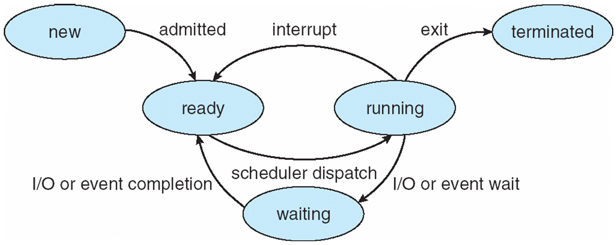
Steps in the ISR
In Demand Paging
Trap to the operating system
Save the user registers and process state
Determine that the interrupt was a page fault
Check that the page reference was legal and determine the location of the page on the disk
Get a free frame
Issue a read from the disk to a free frame:
Wait in a queue for this device until the read request is serviced
Wait for the device seek and/or latency time
Begin the transfer of the page to a free frame
While waiting, allocate the CPU to some other user
Receive an interrupt from the disk I/O subsystem (I/O completed)
Save the registers and process state of the running process
Determine that the interrupt was from the disk
Correct the page table and other tables to show page is now in memory
Wait for the CPU to be allocated to this process again
Restore the user registers, process state, and new page table, and then resume the interrupted instruction

Slide 89
Performance of Demand Paging
Demand paging affects the performance of the computer systems
Page Fault Rate 0 ≤ p ≤ 1
if p = 0 no page faults
if p = 1, every reference is a fault
Effective Access Time (EAT)
EAT = (1 – p) x memory access
+ p (page fault overhead
+ swap page out
+ swap page in
+ restart overhead
)

Slide 90
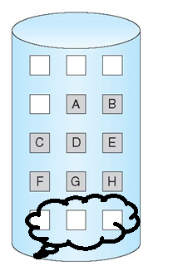
Demand Paging Example
Memory access time = 200 nanoseconds
Average page-fault service time = 8 milliseconds
EAT = (1 – p) x 200 + p (8 milliseconds)
= (1 – p ) x 200 + p x 8,000,000
= 200 + p x 7,999,800
If one access out of 1,000 causes a page fault, then
EAT = 8.2 microseconds.
This is a slowdown by a factor of 40!!
If want performance degradation < 10 percent
220 > 200 + 7,999,800 x p 20 > 7,999,800 x p
p < .0000025
< one page fault in every 400,000 memory accesses
Better utilization of swap space
Swap space

Slide 91
Allocation of Frames
How do we allocate the fixed amount of memory among various processes?
Single user system
Trivial

Slide 92
Allocation of Frames
Each process needs minimum number of frames
Minimum number is defined by the instruction set
Page fault forces to restart the instruction
Enough frames to hold all the pages for that instruction
Example:
Single address instruction (2 frames)
Two address instruction (3 frames)
Maximum of course is total frames in the system
Two major allocation schemes
fixed allocation
proportional allocation

Slide 93
Fixed and proportional Allocation
Equal allocation – m frames and n processes
Each process gets m/n
For example, if there are 100 frames (after allocating frames for the OS) and 5 processes, give each process 20 frames
Keep some as free frame buffer pool
Unfair for small and large sized processes
Proportional allocation – Allocate according to the size of process
Dynamic as degree of multiprogramming, process sizes change

Slide 94
Priority Allocation
Allocation of frames
Depends on multiprogramming level
Use a proportional allocation scheme using priorities along with size

Slide 95
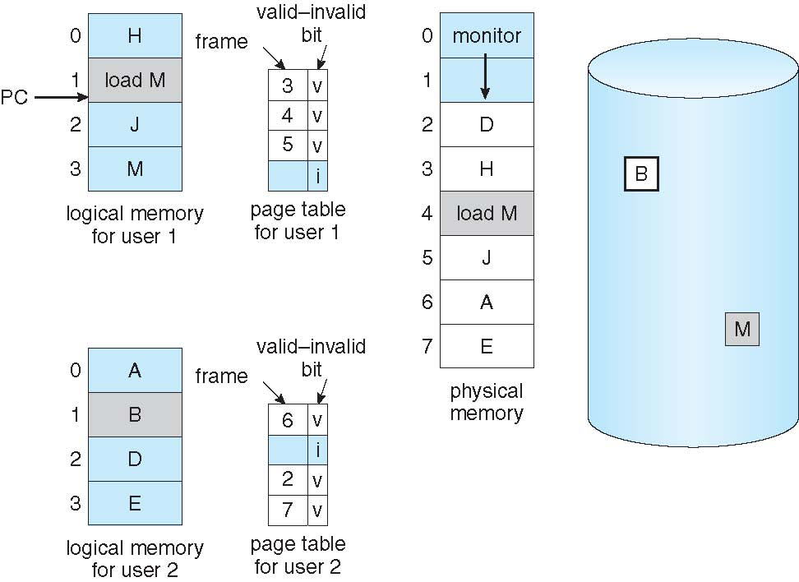
Need For Page Replacement
P1
K
P2

Slide 96
Need For Page Replacement
P1
K
P2
PC

Slide 97
Basic Page Replacement
Find the location of the desired page on disk
Find a free frame: - If there is a free frame, use it - If there is no free frame, use a page replacement algorithm to select a victim frame (of that process) - Write victim frame to disk
Bring the desired page into the (newly) free frame; update the page and frame tables
Continue the process by restarting the instruction that caused the trap
Note now potentially 2 page transfers for page fault – increasing Effective memory access time

Slide 98
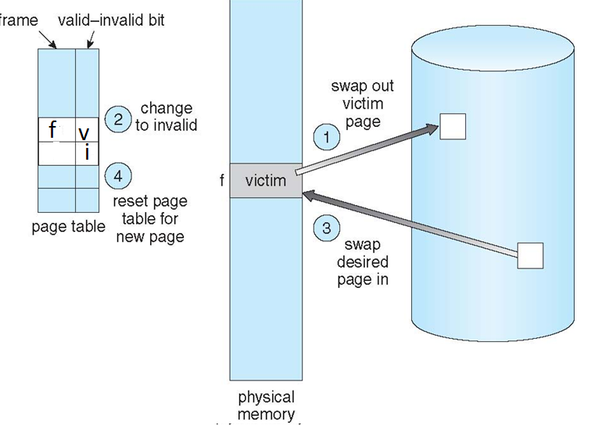
Page Replacement
5
5
6
6

Slide 99
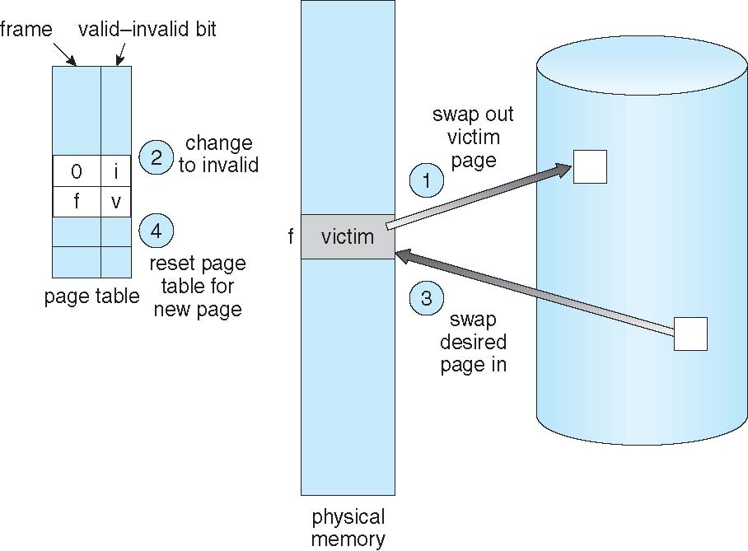
Page Replacement
5
5
6
6

Slide 100
Evaluation
Evaluate algorithm by running it on a particular string of memory references (reference string) and computing the number of page faults on that string
String is just page numbers, not full addresses
Repeated access to the same page does not cause a page fault
Trace the memory reference of a process
0100, 0432, 0101, 0612, 0102, 0104, 0101, 0611, 0102
Page size 100B
Reference string 1, 4, 1, 6, 1, 6
In all our examples, the reference string is
7,0,1,2,0,3,0,4,2,3,0,3,0,3,2,1,2,0,1,7,0,1

Slide 101
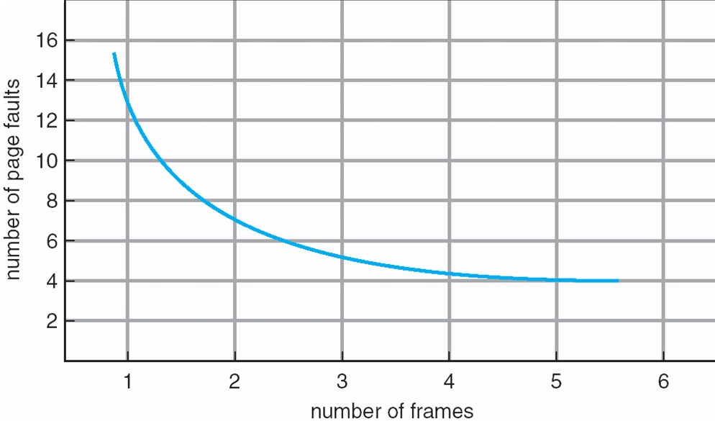
Graph of Page Faults Versus The Number of Frames

Slide 102
First-In-First-Out (FIFO) Algorithm
Associates a time with each frame when the page was brought into memory
When a page must be replaced, the oldest one is chosen
Reference string: 7,0,1,2,0,3,0,4,2,3,0,3,0,3,2,1,2,0,1,7,0,1
Limitation:
A variable is initialized early and constantly used

Slide 103
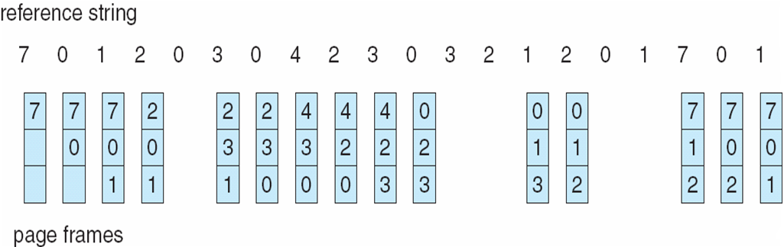
FIFO Page Replacement
3 frames (3 pages can be in memory at a time)
15 page faults
How to track ages of pages?
Just use a FIFO queue to hold all the pages in memory
Replace the page at the head
Insert at tail

Slide 104
Optimal Algorithm
Replace page that will not be used for longest period of time
How do you know this?
Can’t read the future
Used for measuring how well your algorithm performs

Slide 105
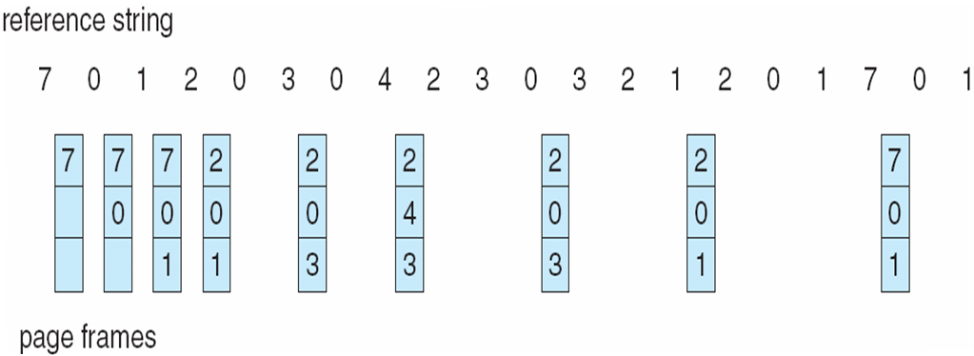
Optimal Page Replacement
9 page faults

Slide 106
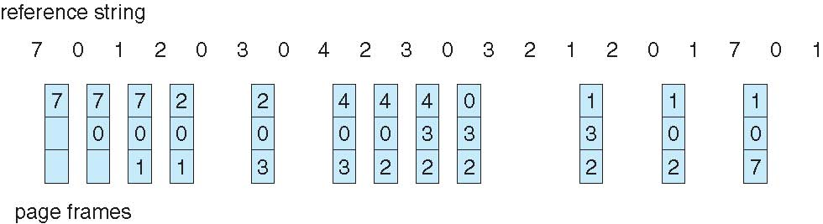
Least Recently Used (LRU) Algorithm
Use past knowledge rather than future
Past is the proxy of future
Replace page that has not been used in the most of the time
Associate time of last use with each page
12 faults – better than FIFO but worse than OPT
Generally good algorithm and frequently used
But how to implement?

Slide 107
LRU Algorithm-Implementation
Counter implementation
CPU maintains a clock
Every page entry has a Time of use;
every time page is referenced, copy the clock into the time of use
When a page needs to be replaced, look at the “Time of use” to find smallest value
Search through table needed
Page table
 |  | Time of Use
Clock
CPU
0
1
address
2
3

Slide 108
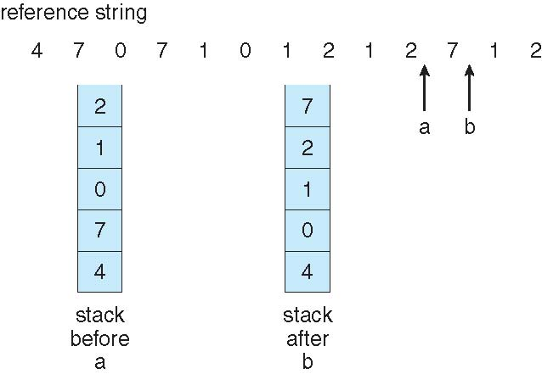
LRU Algorithm-Implementation
Stack implementation
Keep a stack of page numbers in a double linked list form:
Page referenced:
move it to the top
Victim page is the bottom page

Slide 109
LRU Approximation Algorithms
LRU needs special hardware and still slow
Reference bit
With each page associate a bit, initially = 0
When page is referenced bit set to 1
Additional reference bit algorithm
Record the reference bits in regular interval
Keep a 8 bit string for each page in memory
At regular interval, timer copies the reference bit to the high order bit (MSB) of the string.
Shift the other bits right side by one bit

Slide 110
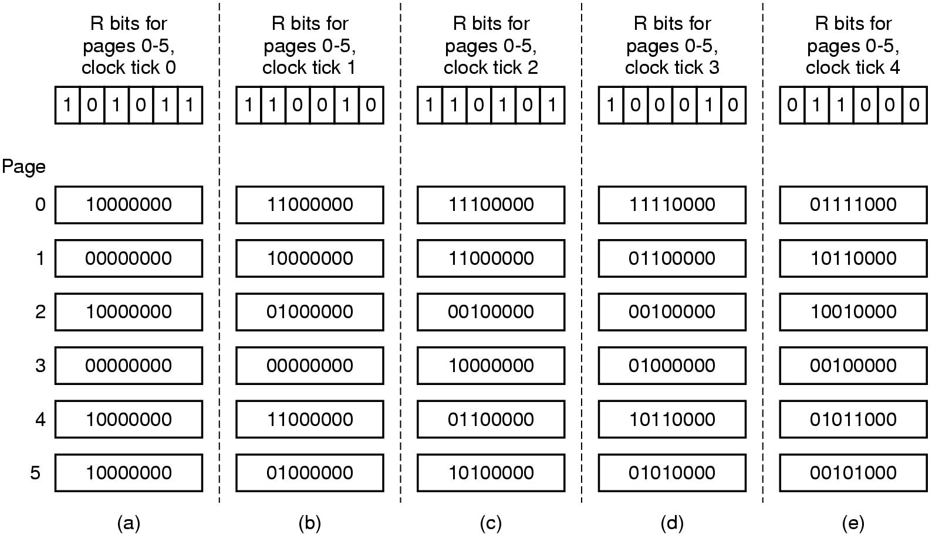
Reset
reference
LRU Approximation Algorithms
Period
Period
Period
0
1
2
3
4
5
0
1
2
3
4
5
0
1
2
3
4
5

Slide 111
LRU Approximation Algorithms
LRU needs special hardware and still slow
Reference bit
With each page associate a bit, initially = 0
When page is referenced bit set to 1
Additional reference bit algorithm
Second-chance algorithm
Generally FIFO, plus hardware-provided reference bit
Clock replacement
If page to be replaced has
Reference bit = 0 -> replace it
reference bit = 1 then:
set reference bit 0, leave page in memory (reset the time)
replace next page, subject to same rules

Slide 112
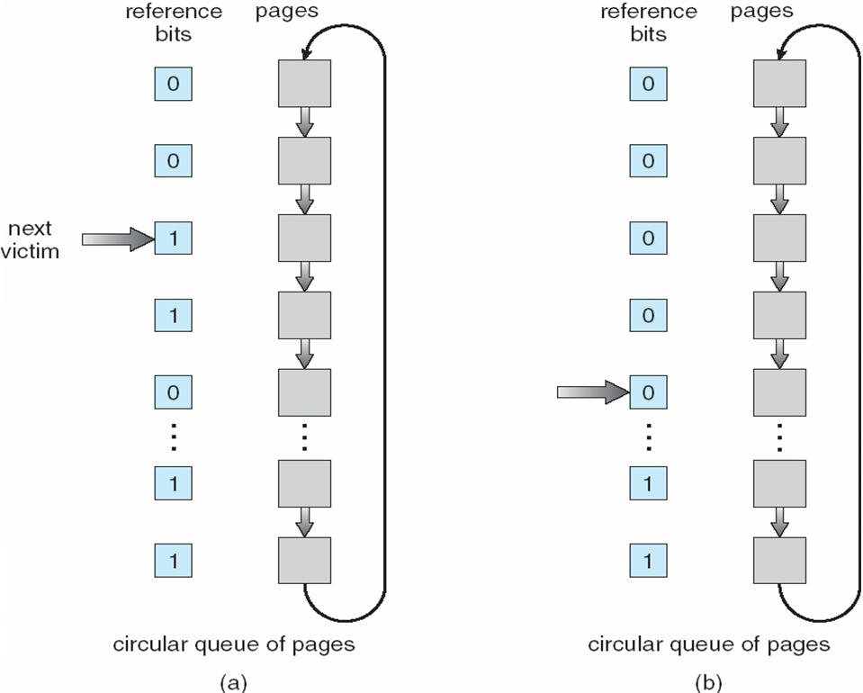
Second-Chance (clock) Page-Replacement Algorithm
{Reference bit, Dirty bit} combination

Slide 113
Counting Algorithms
Keep a counter of the number of references that have been made to each page
LFU Algorithm: replaces page with smallest count
MFU Algorithm: based on the argument that the page with the smallest count was probably just brought in and has yet to be used
Least and most frequently used

Slide 114
Graph of Page Faults Versus The Number of Frames

Slide 115
FIFO Example – Program - 5 pages, 3 frames of Memory allocated
Increase in page frame decreases page fault rate?
1 2 3 4 1 2 5 1 2 3 4 5
9
faults
1
1
2
1
2
3
4
2
3
4
1
3
4
1
2
5
1
2
5
1
2
5
1
2
5
3
2
5
3
4
5
3
4










Slide 116
FIFO Example – Program - 5 pages, 4 frames of Memory allocated
1 2 3 4 1 2 5 1 2 3 4 5
1
1
2
1
2
3
4
2
3
4
1
3
4
1
2
5
1
2
5
1
2
5
1
2
5
3
2
5
3
4
5
3
4
10
faults
1
1
2
1
2
3
1
2
3
4
1
2
3
4
1
2
3
4
5
2
3
4
5
1
3
4
5
1
2
4
5
1
2
3
4
1
2
3
4
5
2
3











Slide 117
Belady's Anomaly
# of Page Faults
Number of Frames

Slide 118
Belady’s Anomaly
This most unexpected result is known as Belady’s anomaly – for some page-replacement algorithms, the page fault rate may increase as the number of allocated frames increases
Is there a characterization of algorithms susceptible to Belady’s anomaly?

Slide 119
Stack Algorithms
Certain page replacement algorithms are more “well behaved” than others
(In the FIFO example), the problem arises because the set of pages loaded with a memory allocation of 3 frames is not necessarily also loaded with a memory allocation of 4 frames.
There are a set of paging algorithms whereby the set of pages loaded with an allocation of m frames is always a subset of the set of pages loaded with an allocation of m +1 frames. This property is called the inclusion property
Algorithms that satisfy the inclusion property are not subject to Belady’s anomaly. FIFO does not satisfy the inclusion property and is not a stack algorithm

Slide 120
LRU algorithm
6 5 3
6
4
3
9
3
5
6
6
3
5
4
6
3
5
3
4
6
5
9
3
4
6
5
In memory
3 frames
Outside memory
3
5
6
6
3
5
4
6
3
5
3
4
6
5
9
3
4
6
5
In memory
4 frames

Slide 121
Global vs. Local Allocation
Frames are allocated to various processes
If process P_{i} generates a page fault
select for replacement one of its frames
select for replacement a frame from another process
Local replacement – each process selects from only its own set of allocated frames
More consistent per-process performance
But possibly underutilized memory
Global replacement – process selects a replacement frame from the set of all frames; one process can take a frame from another
But then process execution time can vary greatly
But greater throughput ----- so more common
Processes can not control its own page fault rate
Depends on the paging behavior of other processes

Slide 122
Thrashing
If a process uses a set of “active pages”
Number of allocated frames is less than that
Page-fault
Replace some “active” page
But quickly need replaced “active” frame back
Quickly a page fault, again and again
Thrashing ≡ a process is busy swapping pages in and out
OS monitors CPU utilization
If low? Increase the degree of multiprogramming

Slide 123
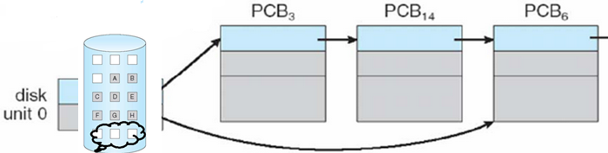
Thrashing
Global page replacement
Process enters new phase (subroutine call) execution
Page fault
Taking frames from other processes
Replace “active” frames of other processes
These processes start page fault
These faulting processes wait on the device queue for disk
Ready queue empty
CPU utilization decreases
CPU scheduler increases the degree of multiprogramming
More page faults
Drop in CPU utilization
Page fault increases tremendously
Disk

Slide 124
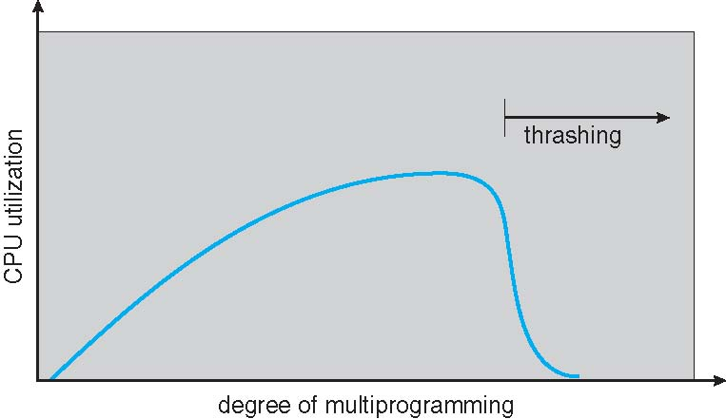
Thrashing (Cont.)

Slide 125
Thrashing
Solution
Local replacement
One process cannot steal frames from other processes
Provide a process as many frames as needed
Able to load all active pages
How do we know?
Locality model

Slide 126
Demand Paging and Thrashing
Why does demand paging work? Locality model
Process migrates from one locality to another
Localities may overlap
Allocate enough frames to a process to accommodate its locality
Why does thrashing occur? Σ size of locality > total allocated frames
Limit effects by using local or priority page replacement

Slide 127
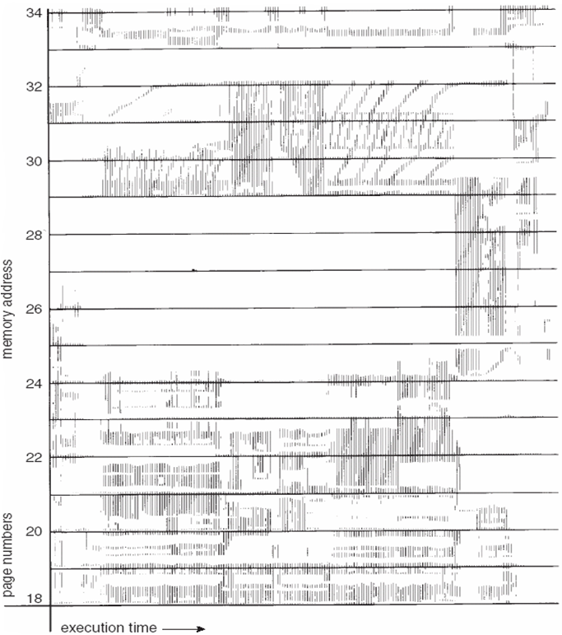
Locality In A Memory-Reference Pattern

Slide 128
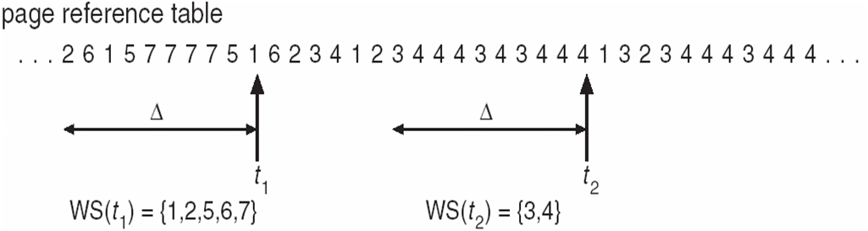
Working-set model

Slide 129
Working-Set Model
Δ ≡ working-set window ≡ a fixed number of page references Example: 10,000 instructions
WSS_{i} (working set of Process P_{i}) = total number of pages referenced in the most recent Δ (varies in time)
if Δ too small will not encompass entire locality
if Δ too large will encompass several localities
if Δ = ∞ ⇒ will encompass entire program
D = Σ WSS_{i} ≡ total demand frames
Approximation of locality
if D > m ⇒ Thrashing
Policy if D > m, then suspend or swap out one of the processes

Slide 130
Page-Fault Frequency
More direct approach than WSS
Establish “acceptable” page-fault frequency (PFF) rate and use local replacement policy
If actual rate too low, process loses frame
If actual rate too high, process gains frame

